Slide 1
Path and trajectory

Slide 2
2D Geometry – Position and Pose
To fully describe an object on the plane we need to not only describe its position, but also which direction it is pointing.
This combination is referred to as pose
Pose (x,y, theta)
Pose is really very useful we also want to talk about how pose changes as a function of time.

Slide 4
Path and Trajectory
Consider the problem with the robot moving from one place to another
It's going to have to follow some kind of path, so its pose will change as a function of time and that leads to two very important concepts that we refer to as a path and a trajectory

Slide 5
Path
It is a way to getting form A to B
A set of points that links to A and B
It says nothing about the speed at which we progress along the path
There is no notion of time

Slide 6
Trajectory
A path and a schedule for getting from A to B
No notion of time or speed

Slide 7
2D Pose

Slide 8
2D pose

Slide 9
3D Pose

Slide 10
Inverse Kinematics

Slide 11
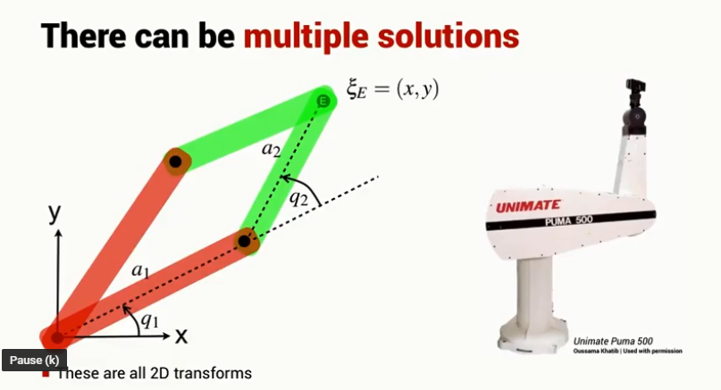
Inverse kinematics

Slide 12
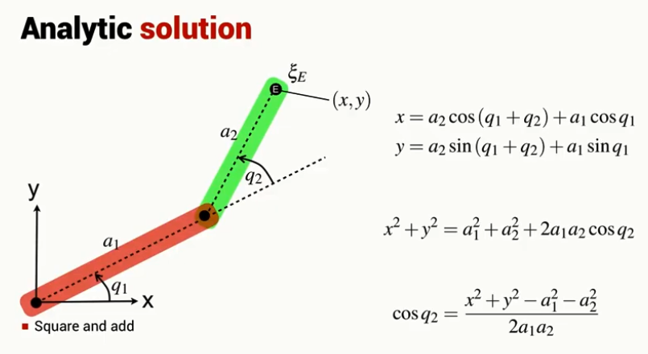
Inverse kinematics

Slide 13
Inverse kinematics

Slide 14
Inverse kinematics

Slide 15
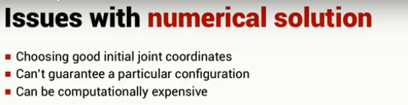
Inverse Kinematics

